Slide 1

Sanitation Assainissement Eau Potable (S.A.E.P)
This user guide will help you navigate to this console. And display the features available.

Slide 2
S.A.E.P
How to access the console?

Slide 3
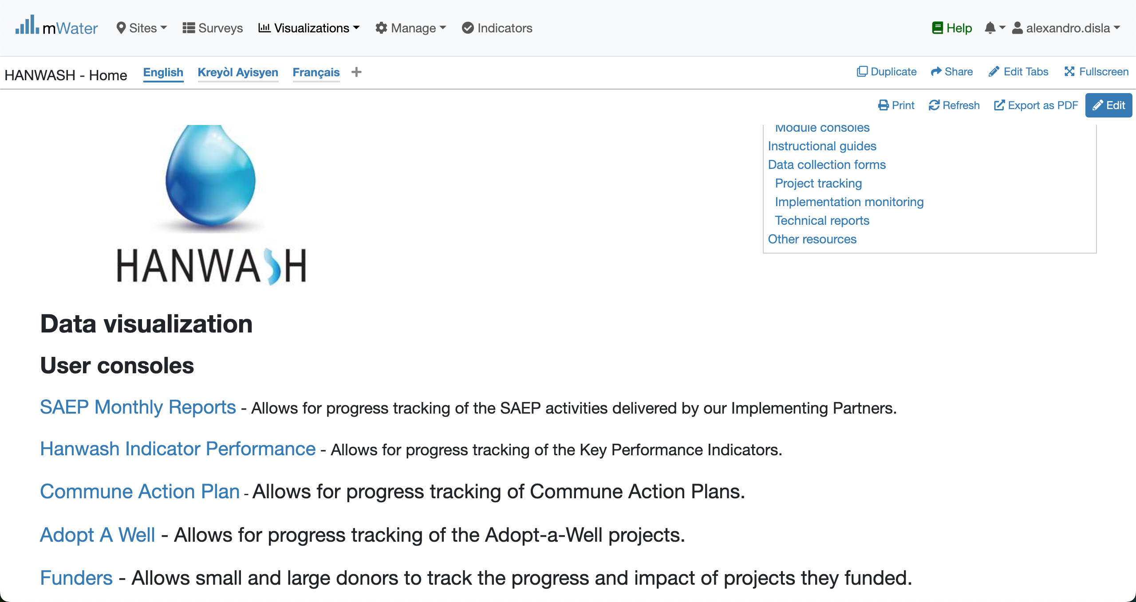
Hanwash HOME
URL LINK : http://go.mwater.co/hanwash

Slide 4
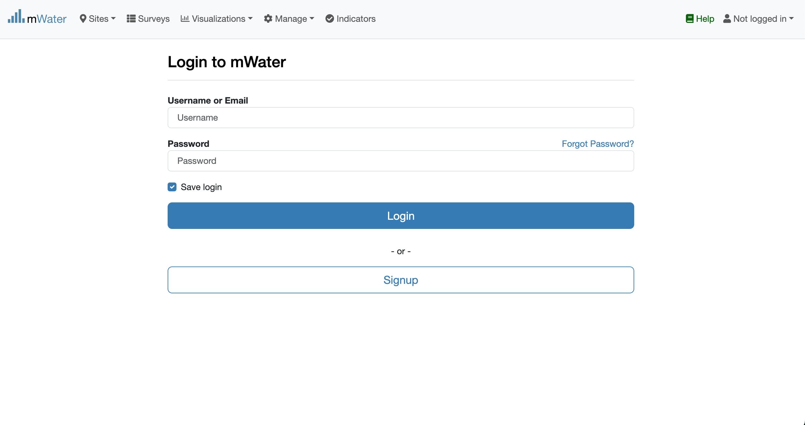
Access The SAEP Console & Login process
Click on the HIP url link
Log status indicator
Please enter your Credentials

Slide 5

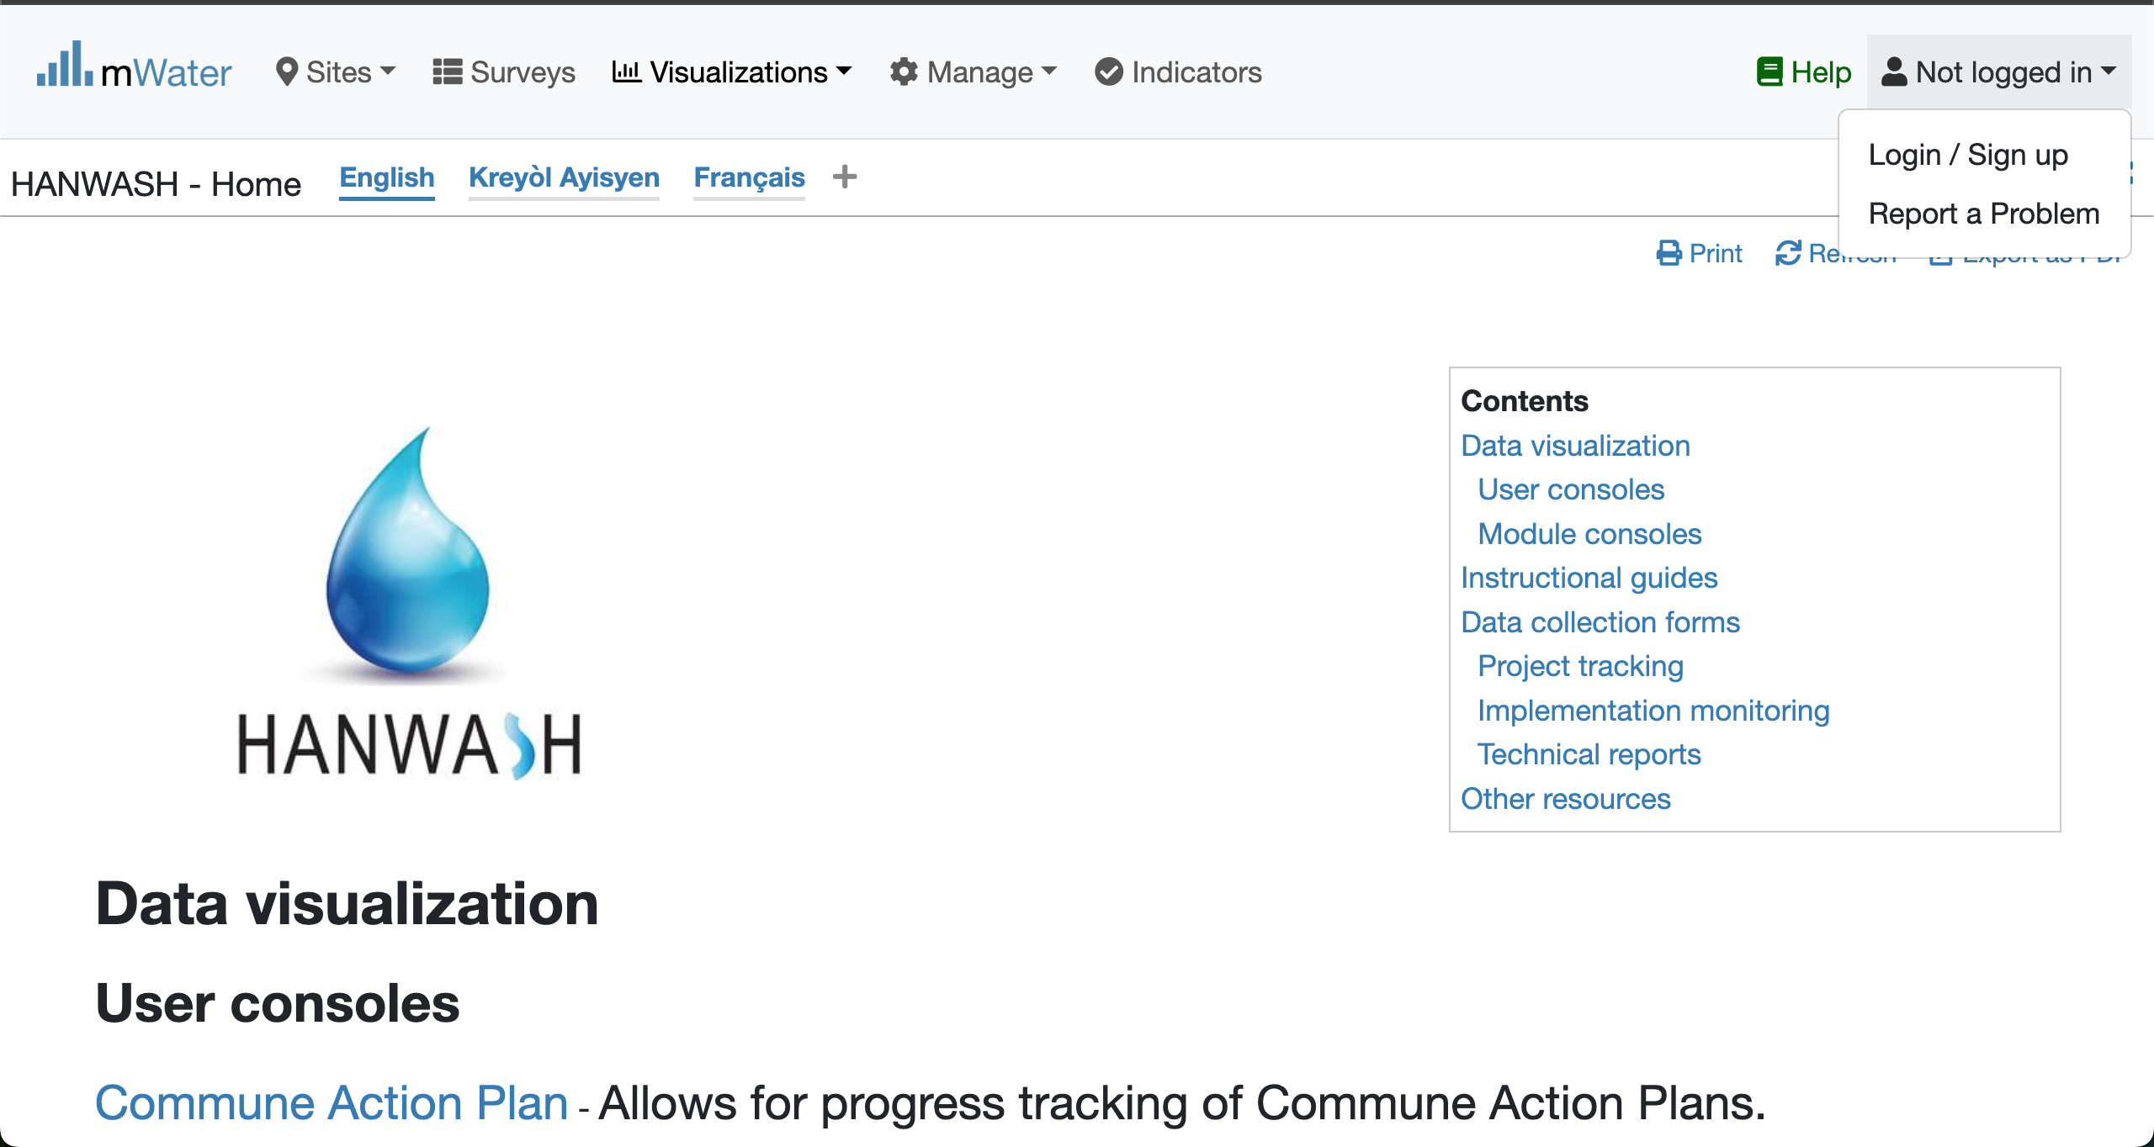


Login Process (2nd scenario)
Click to Login or Signup
Please Click on this selection box
Please enter your Credentials

Slide 6
Console Overview
1. The Introduction (Static)
2. SAEP Monthly Report

Slide 7
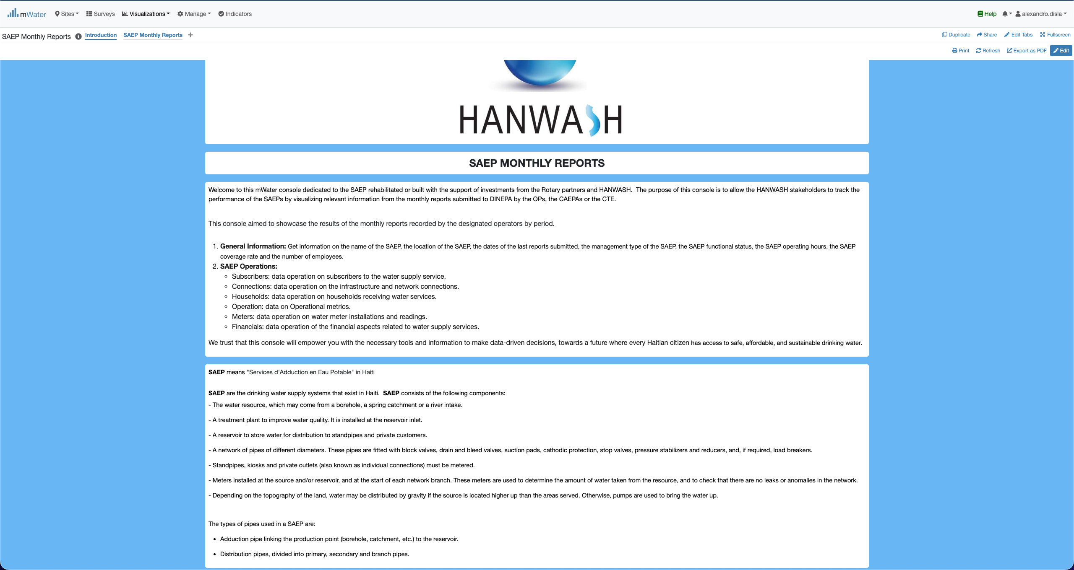
S.A.E.P Console overview

Slide 8
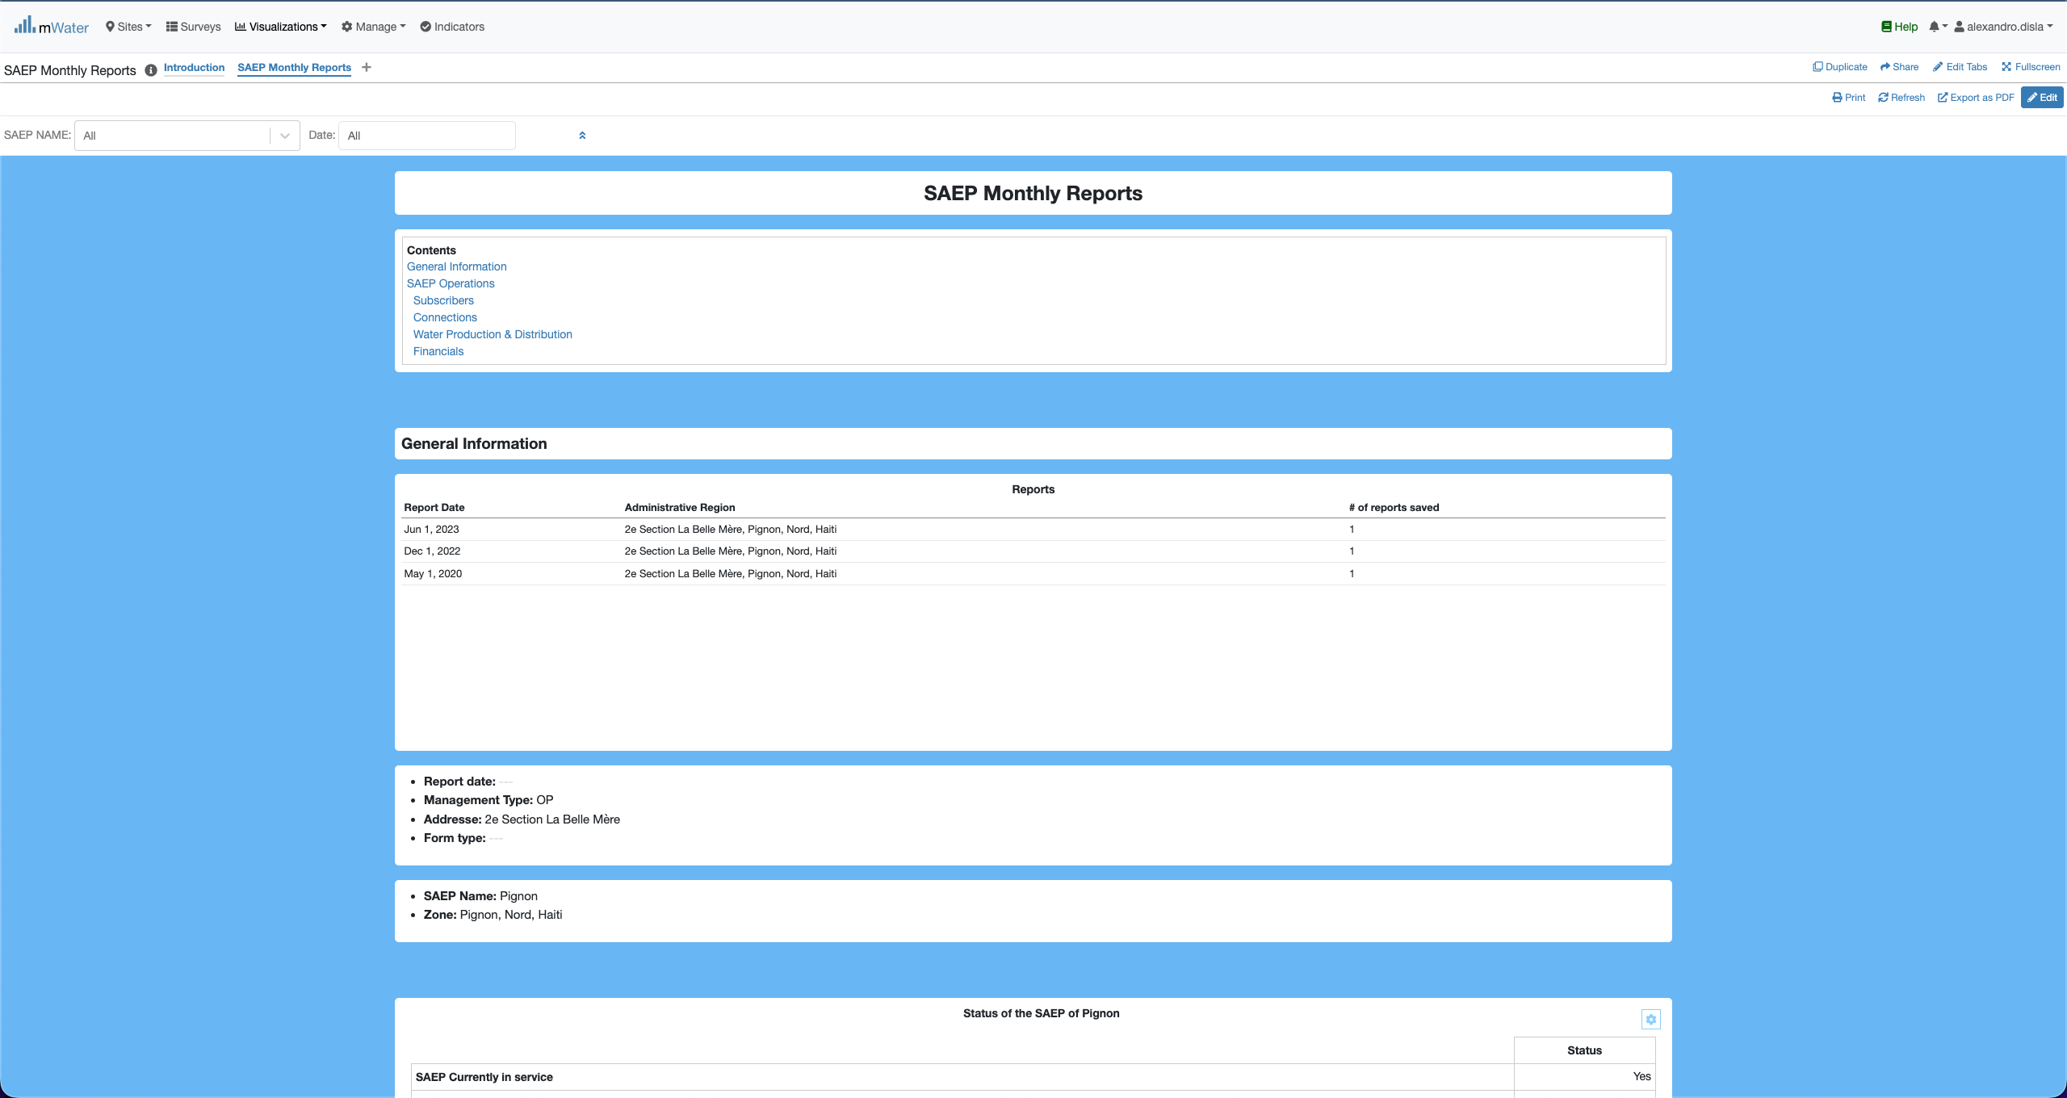
S.A.E.P Console overview

Slide 9
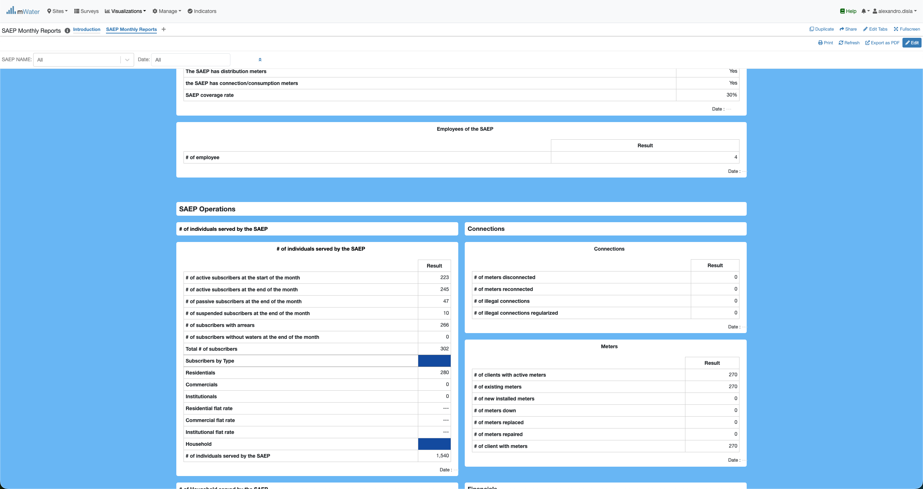
S.A.E.P Console overview

Slide 10
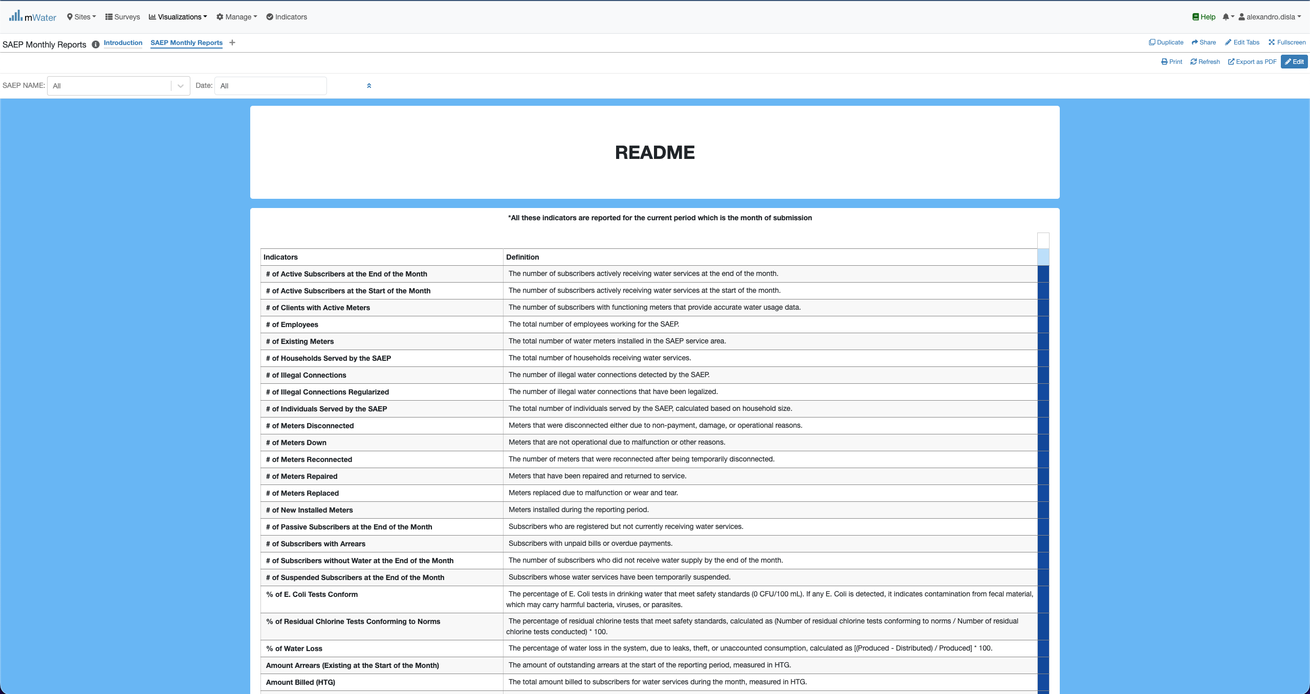
S.A.E.P Console overview

Slide 11
Functionalities
What are functionalities available?

Slide 12
The Main page
SAEP Monthly Reports:
General Information
SAEP Operations
Subscribers
Connections
Water Production & Distribution
Financials

Slide 13
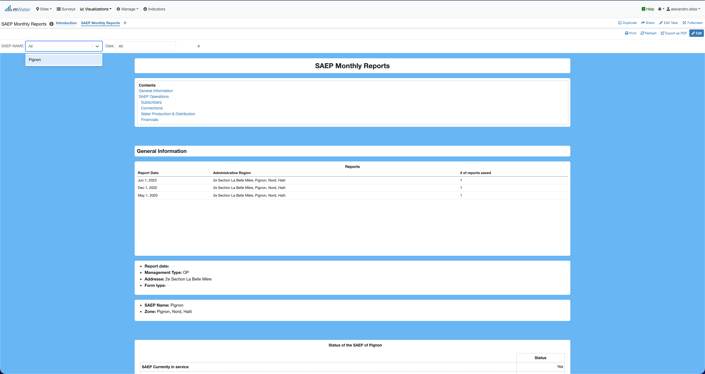
Quick filters
The SAEP Name and any future saep will be display in this dropdown list.

Slide 14
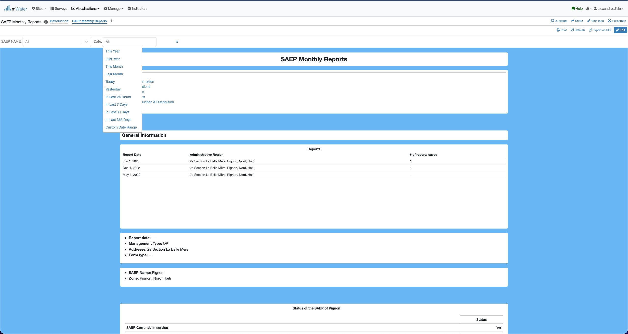
Quick filters
The Date offers us the full flexibility to work filter for a specific day or period.
This section will display all the available report for all the saep. Right now, it displays the reports for Pignon. It will help for the selection of the period.

Slide 15
How to select a report date
One of the main feature available on this Console

Slide 16
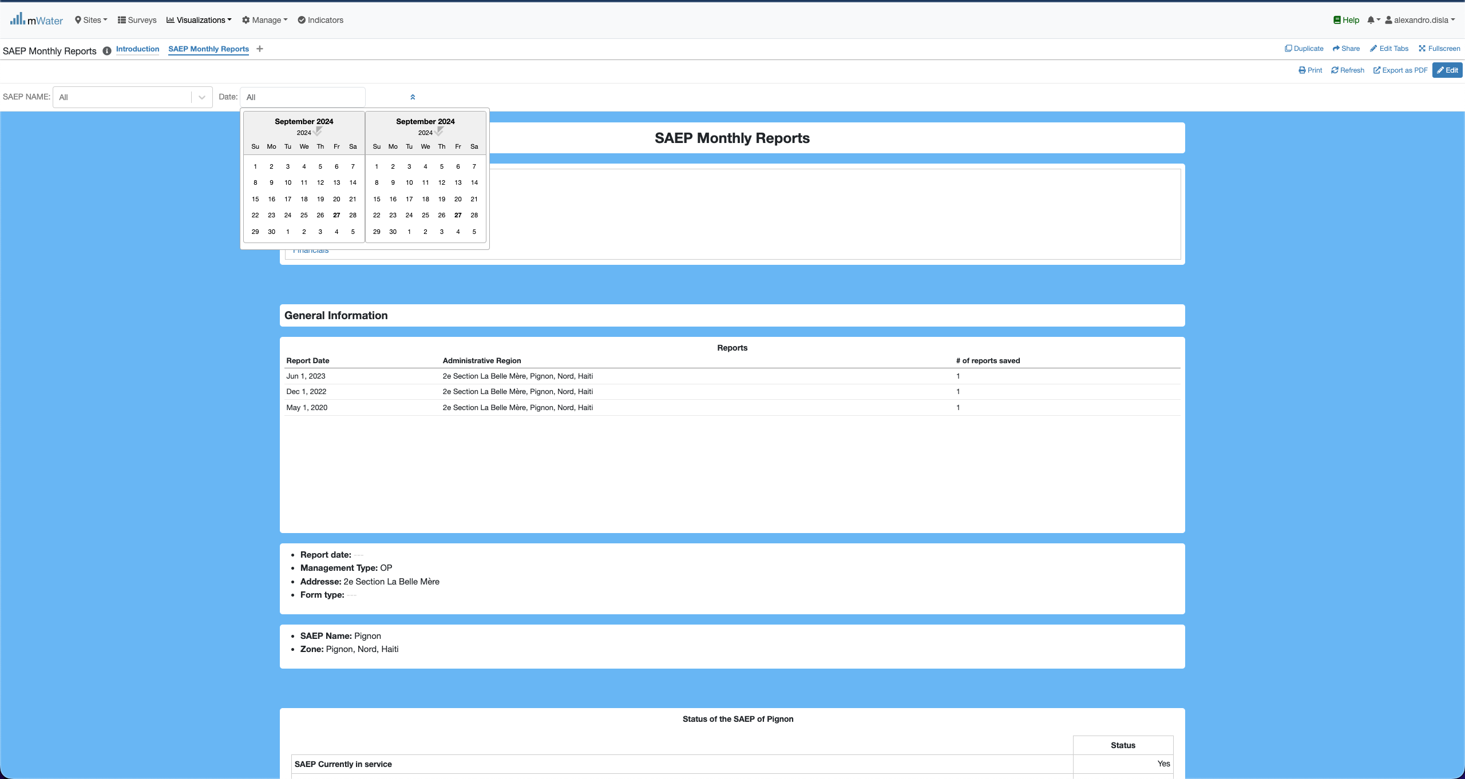
Report date
You have to have the selected in this format display lke this: 01 Jun 2023 – 01 Jun 2023
As indicated in the first table in below. We have 3 recorded reports date.

Slide 17
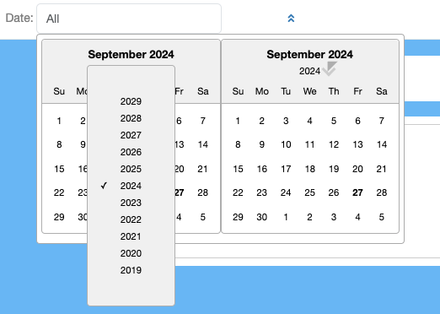
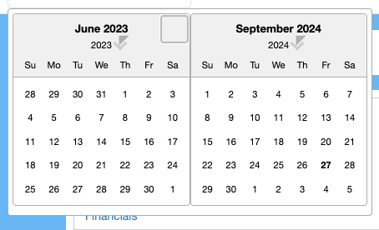
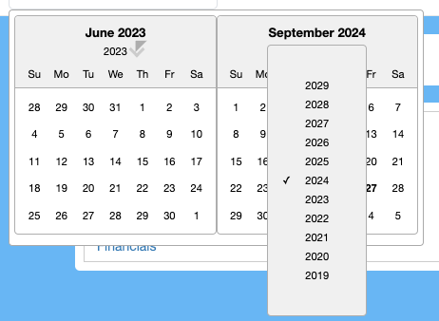
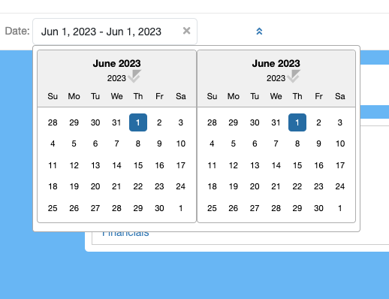
Report Date
Click on 2024, to display the month list
Click on the left or rigth side to change the months

Slide 18
Effect
Effect of The Quick Filters

Slide 19
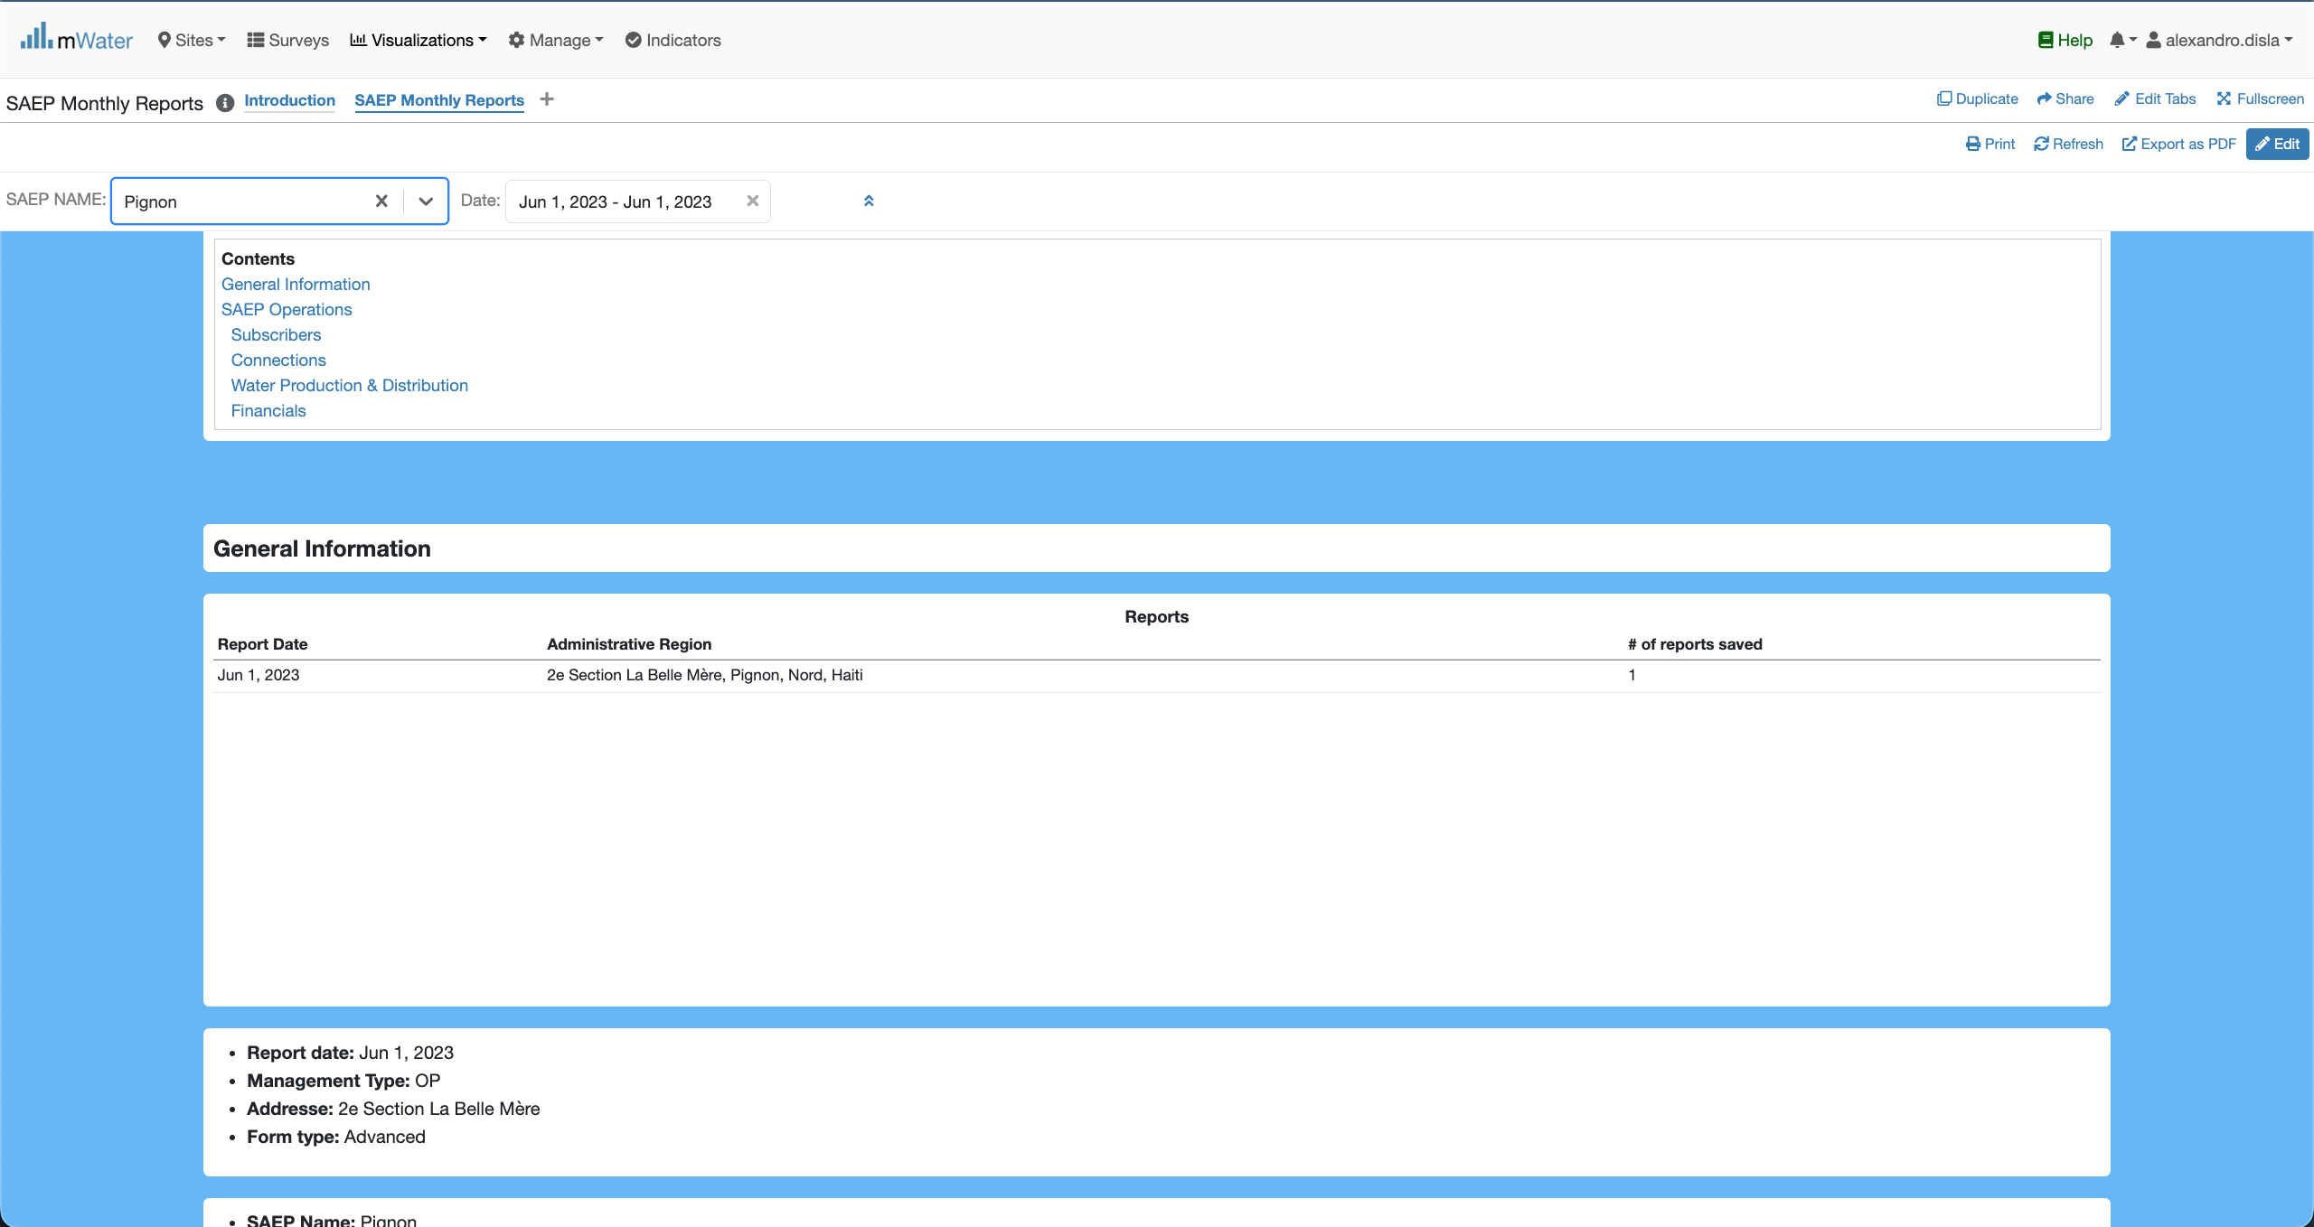
Quick Filters Selection
Now we have the date of a report selected. Plus we can add the saep name.
All the component will react to display the available results

Slide 20
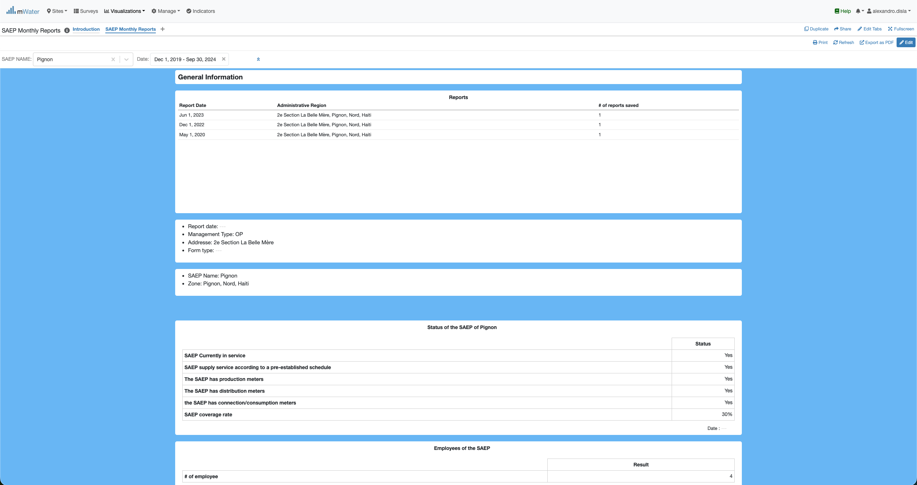
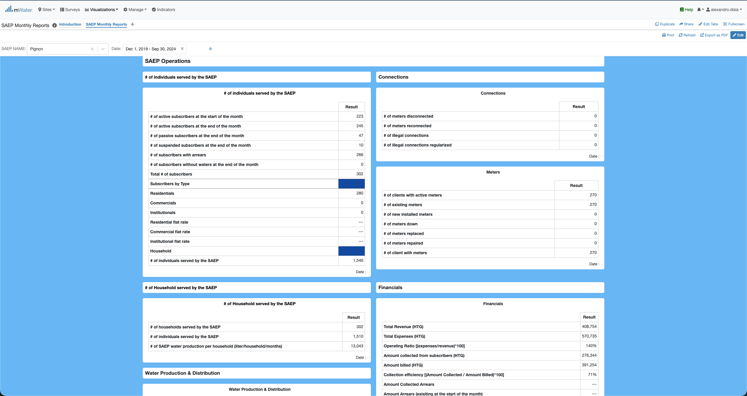
Quick Filters Selection
The General information section
The saep operation section

Slide 21
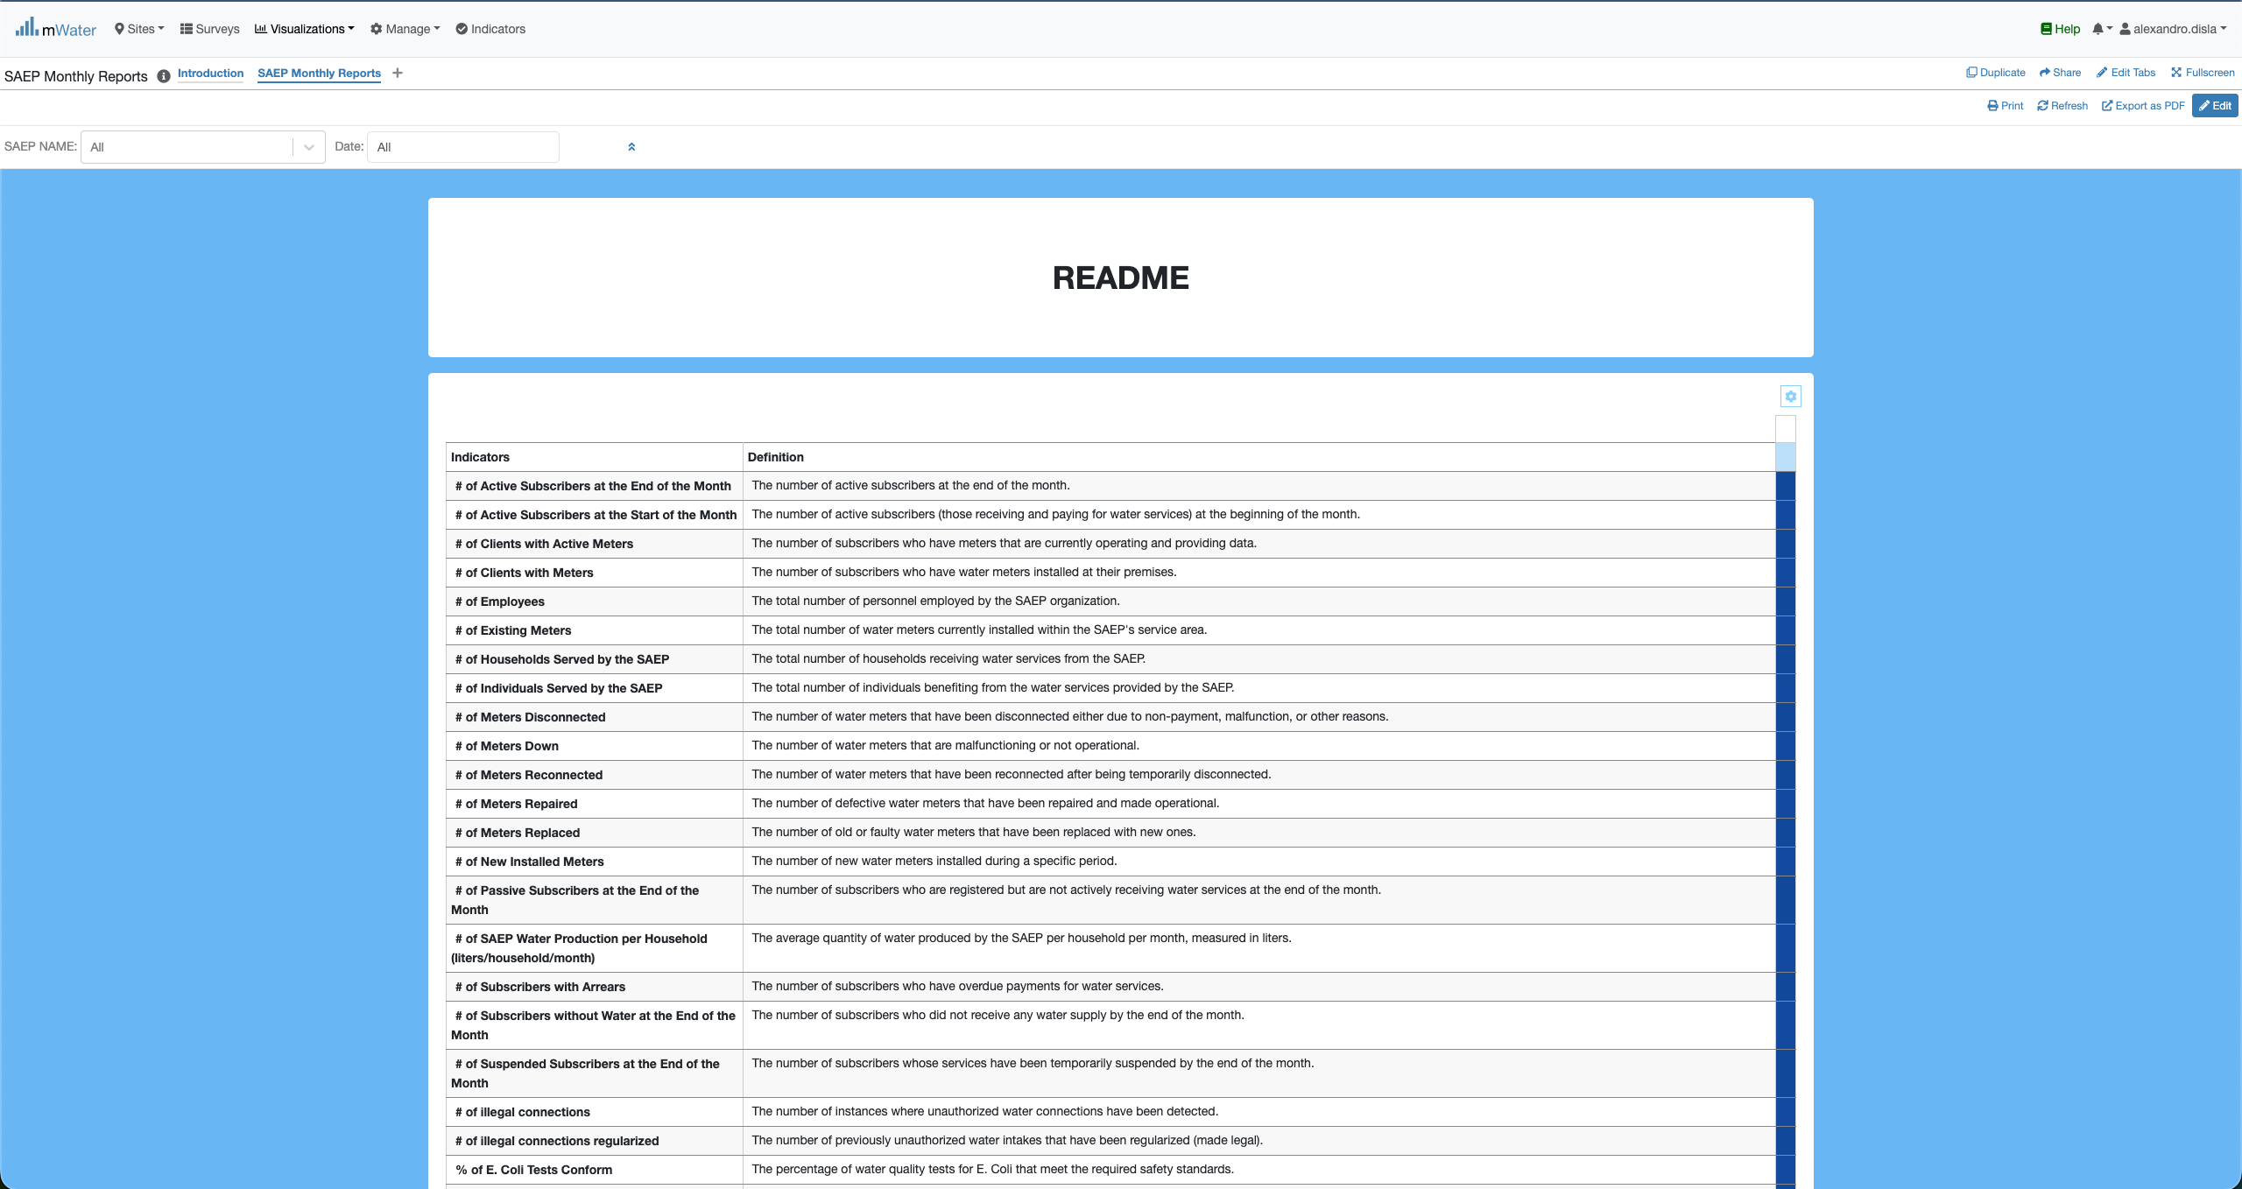
Readme section
This readme is in place to help better understand the key information displayed in the general information and operation sections.

Slide 22
Export

Slide 23
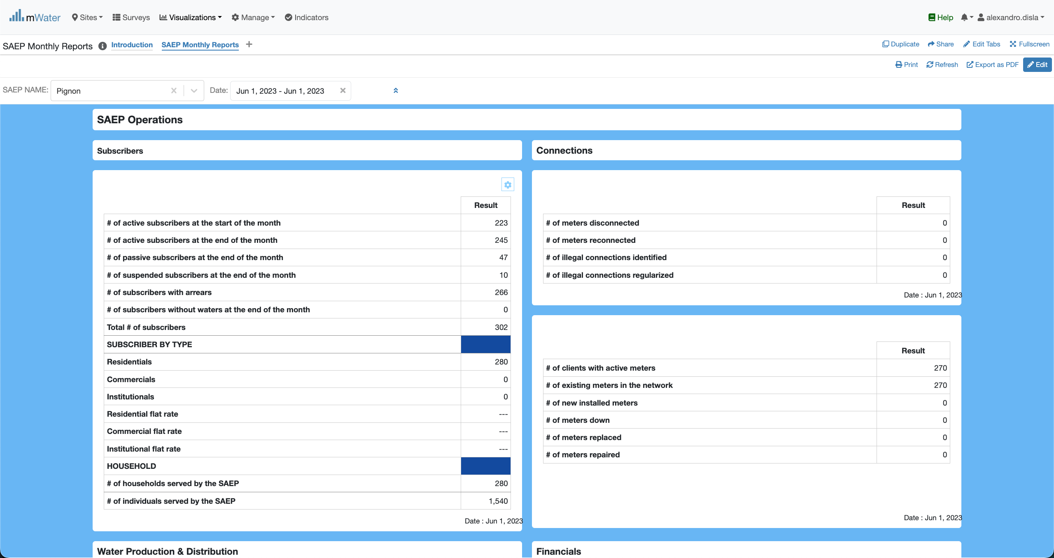
Export from the tables
Hover the cursor over one of the table of your choice. And you click on this button

Slide 24

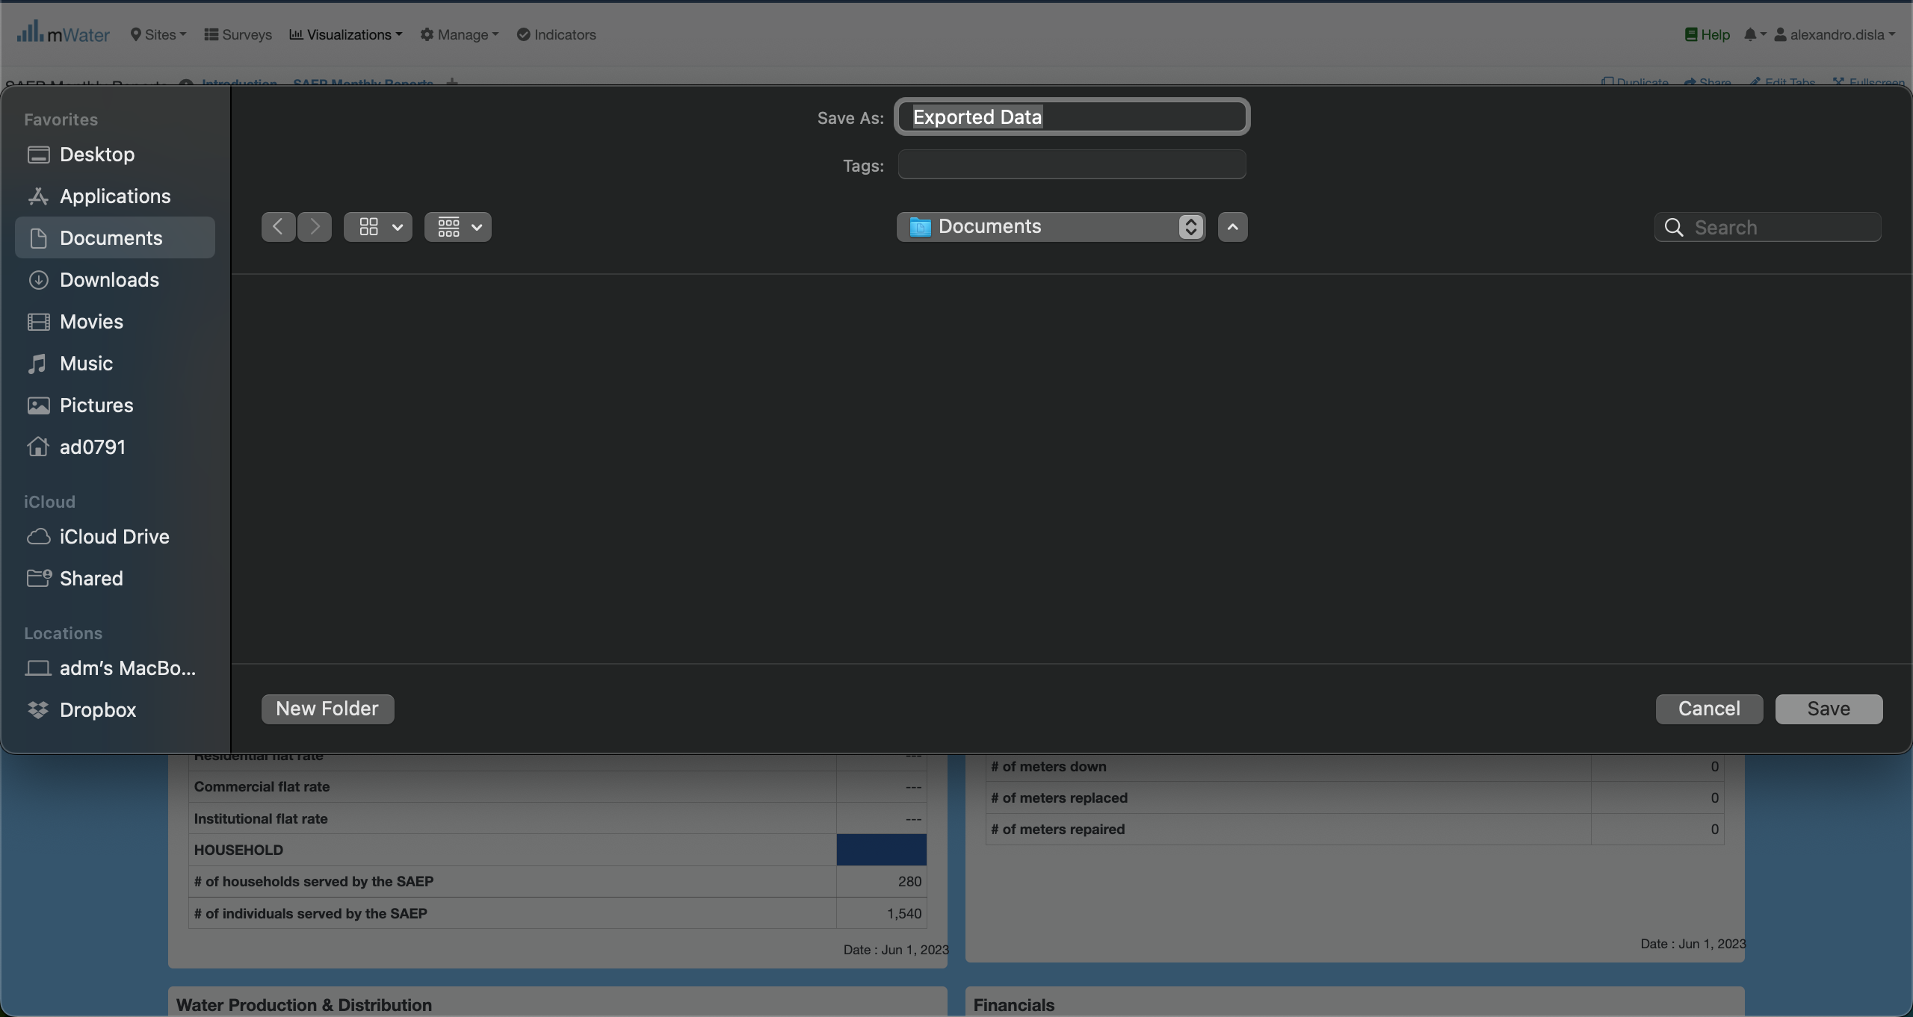
Export from the tables
This will trigger the modal with the download platform.
You can change the name of the export as well as the target location as you see fit.
Depending of your operating system, the export will be saved either on Documents or Downloads

Slide 25
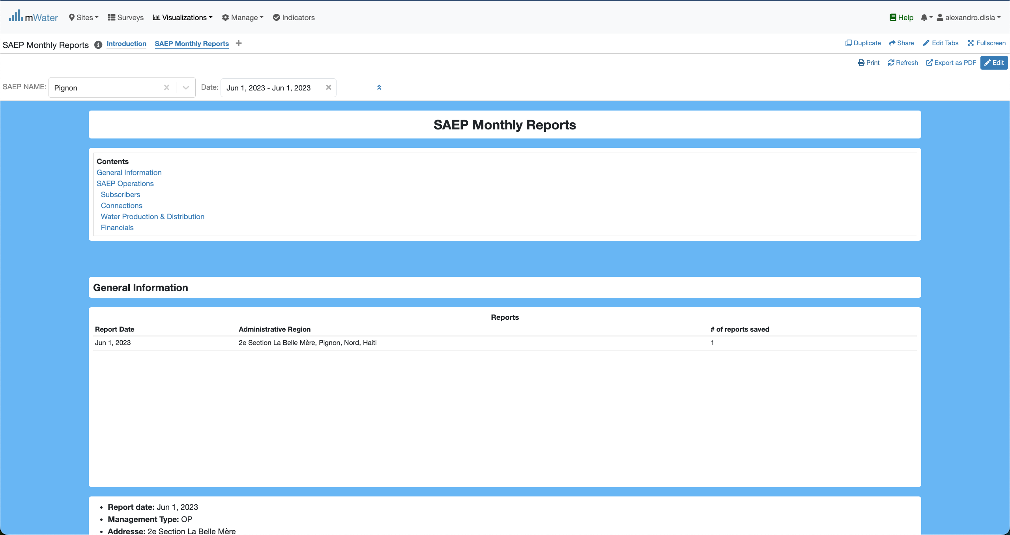
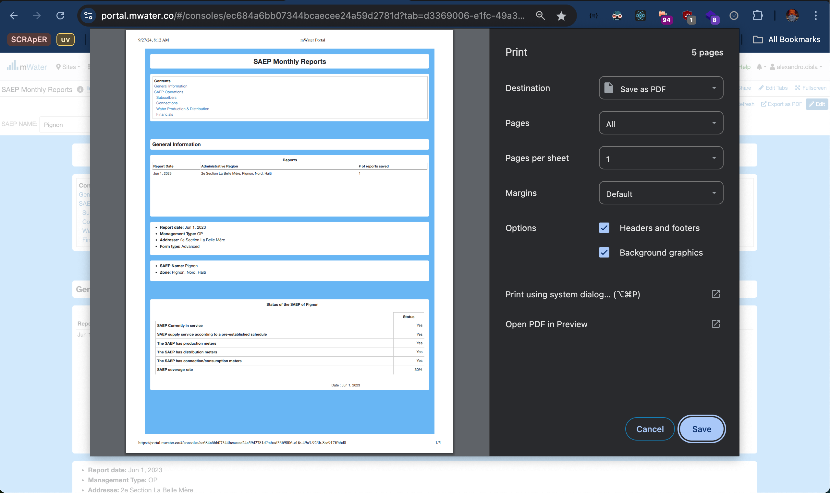
Print Export
The print Icon is another option available.
A very clear interface will help you extract the report in pdf format for your convenience.

Slide 26
Thank You !!!
PLEASE FEEL FREE TO CONTACT ME BY :
Email / alexandro.disla@hanwash.org
Whatsap or Phone / +50941483700

